Slide 1

Fall 2011
Chapter 1
Writing a Program

Slide 2
Class Overview
Course Information
  On the web page and Blackboard
  www.uncp.edu/home/lilliec/
  Syllabus
  Assignments
  Homework
  Exams
  Attendance Policy
Textbook
  Tsui & Karam, Essentials of Software Engineering

Slide 3
Objectives
Analyze issues for simple programs
  Requirements
  Design Constraints
  Testing
  Error Estimation
  Implementation details
Understand sequence of activities
Preview of future topics

Slide 4
Requirements
Requirements – define and qualify system
  Defined by client, with help from engineer
  Functional – define what must be done
  Non-Functional – qualify the functional ones
Design constraints
  On design or implementation
  Programming language, platforms etc

Slide 5
A Simple Problem
Given a collection of lines of text (strings) stored in a file, sort them in alphabetical order and write them to another file
This is the requirement

Slide 6
Functional requirements
Input format
  Character size
  Line separator
Specify Sorting
  Numbers
  Upper/lowercase
Special cases
Boundaries
Error Conditions

Slide 7
Nonfunctional requirements
Performance
Real-time ?
Modifiability

Slide 8
Design Constraints
User Interface
  GUI, CLI, Web …
Typical input and size
Platforms
Schedule

Slide 9
Design Decisions
Programming Languages
Algorithms

Slide 10
Testing
White-Box – test the code as written
Black-Box – assume no knowledge of code
Unit testing – by programmer, on each piece
Integration Testing – Put the units together into bigger system
Acceptance testing – if it fails, client rejects program

Slide 11
Estimating
How much effort is required ?
  Usually done in person-months
Cost
  Once know the effort can estimate cost
Time / Scheduling
  Once know the effort can estimate schedule

Slide 12
Implementation Rules
Be consistent
Choose names carefully
Test before using
  Test, test, test
Know thy libraries
Do code reviews

Slide 13
Basic Design
Class StringSorter
  Read
  Sort
  Write
  Wrapper to do Read then Sort then Write
Will unit-test each method
Will use ArrayList to hold the lines

Slide 14
Implement
import java.io.*; // for Reader(s), Writer(s), IOException
import java.util.*; // for List, ArrayList, Iterator
public class StringSorter {
ArrayList lines;
public void readFromStream(Reader r) throws IOException
{
BufferedReader br=new BufferedReader(r);
lines=new ArrayList();
while(true) {
String input=br.readLine();
if(input==null)
break;
lines.add(input);
}
}

Slide 15
Test
public class TestStringSorter extends TestCase {
private ArrayList make123() {
ArrayList l = new ArrayList();
l.add("one");
l.add("two");
l.add("three");
return l;
}
public void testReadFromStream() throws IOException{
Reader in=new FileReader("in.txt");
StringSorter ss=new StringSorter();
ArrayList l= make123();
ss.readFromStream(in);
assertEquals(l,ss.lines);
}

Slide 16
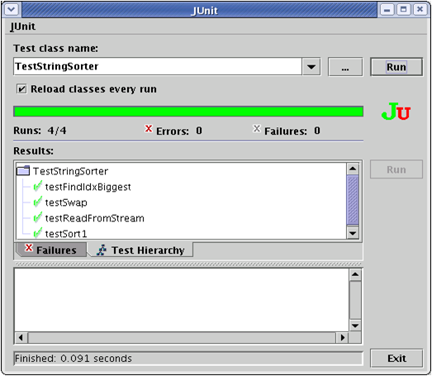
Figure 1.5: Junit GUI

Slide 17
Implement
static void swap(List l, int i1, int i2) {
Object tmp=l.get(i1);
l.set(i1, l.get(i2));
l.set(i2, tmp);
}

Slide 18
Test
public void testSwap() {
ArrayList l1= make123();
ArrayList l2=new ArrayList();
l2.add("one");
l2.add("three");
l2.add("two");
StringSorter.swap(l1,1,2);
assertEquals(l1,l2);
}

Slide 19
Implement
static int findIdxBiggest(List l, int from, int to) {
String biggest=(String) l.get(0);
int idxBiggest=from;
for(int i=from+1; i<=to; ++i) {
if(biggest.compareTo(l.get(i))<0) {// it is bigger
biggest=(String)l.get(i);
idxBiggest=i;
}
}
return idxBiggest;
}
Figure 1.8: findIdxBiggest method

Slide 20
Test
public void testFindIdxBiggest() {
StringSorter ss=new StringSorter();
ArrayList l = make123();
int i=StringSorter.findIdxBiggest(l,0,l.size()-1);
assertEquals(i,1);
}
Figure 1.9: testFindIdxBiggest method

Slide 21
Implement
public void sort() {
for(int i=lines.size()-1; i>0; --i) {
int big=findIdxBiggest(lines,0,i); swap(lines,i,big);
}
}
Figure 1.10: sort method

Slide 22
Test
public void testSort1() {
StringSorter ss= new StringSorter();
ss.lines=make123();
ArrayList l2=new ArrayList();
l2.add("one");
l2.add("three");
l2.add("two");
ss.sort();
assertEquals(l2,ss.lines);
}
Figure 1.11 testSort1 method

Slide 23
Know thy library
void sort() {
java.util.Collections.sort(lines);
}
A sort routine already exists in java (and most other languages)

Slide 24
Implement
public void writeToStream(Writer w) throws IOException {
PrintWriter pw=new PrintWriter(w);
Iterator i=lines.iterator();
while(i.hasNext()) {
pw.println((String)(i.next()));
}
}
Figure 1.13: writeToStream method

Slide 25
Test
public void testWriteToStream() throws IOException{
// write out a known value
StringSorter ss1=new StringSorter();
ss1.lines=make123();
Writer out=new FileWriter("test.out");
ss1.writeToStream(out);
out.close(); // then read it and compare
Reader in=new FileReader("in.txt");
StringSorter ss2=new StringSorter();
ss2.readFromStream(in);
assertEquals(ss1.lines,ss2.lines);
}

Slide 26
Implement
public void sort(String inputFileName,
String outputFileName)
throws IOException
{
Reader in=new FileReader(inputFileName);
Writer out=new FileWriter(outputFileName);
StringSorter ss=new StringSorter();
ss.readFromStream(in);
ss.sort();
ss.writeToStream(out);
in.close();
out.close();
}

Slide 27
Test
public void testSort2() throws IOException {
// write out a known value
StringSorter ss1=new StringSorter();
ss1.sort("in.txt","test2.out");
ArrayList l=new ArrayList();
l.add("one");
l.add("three");
l.add("two");
// then read it and compare
Reader in=new FileReader("test2.out");
StringSorter ss2=new StringSorter();
ss2.readFromStream(in);
assertEquals(l,ss2.lines);
}
Figure 1.16: testSort2 method

Slide 28
Command-Line interface
import java.io.IOException;
public class StringSorterCommandLine {
public static void main(String args[]) throws IOException {
if(args.length!=2) {
System.out.println("Use: cmd inputfile outputfile");
} else {
StringSorter ss=new StringSorter();
ss.sort(args[0],args[1]);
}
}
}

Slide 29
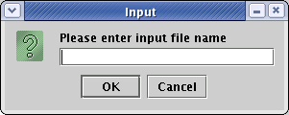
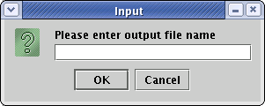
A Bad GUI
public class StringSorterBadGUI {
public static void main(String args[]) throws IOException {
try {
StringSorter ss=new StringSorter();
String inFileName=JOptionPane.showInputDialog
("Please enter input file name");
String outFileName=JOptionPane.showInputDialog
("Please enter output file name");
ss.sort(inFileName, outFileName);
} finally {
System.exit(1);
}
}

Slide 30
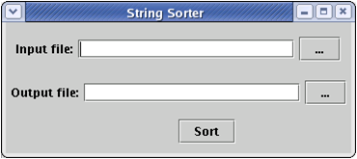
A Better Interface

Slide 31
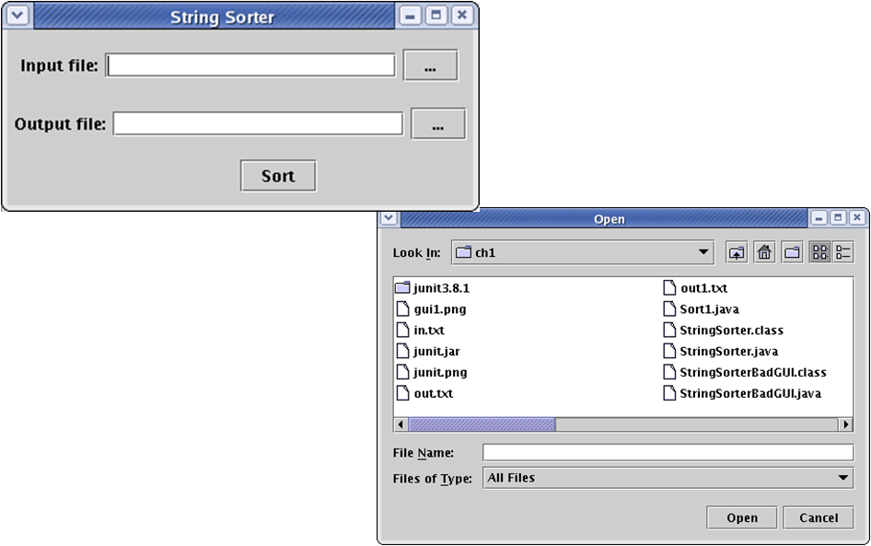
A Better GUI
Click any button, to get the open dialog

